Slide 1

OPTIMUM SOLUTİONS
ENGINEERING
Introduction to Our Engineering
SERIM BAYSUN |
October 12, 2025
Start Slide

Slide 2
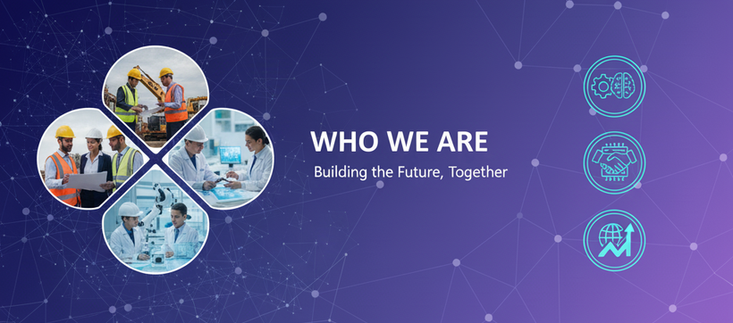
OPTIMUM
Who We Are?
Engineering Excellence
We are an engineering partner dedicated to solving complex industrial challenges through innovative and efficient solutions.
Optimum Solutions Engineering is a full service partner, providing integrated solutions from initial design and manufacturing to comprehensive service and support.

Slide 3

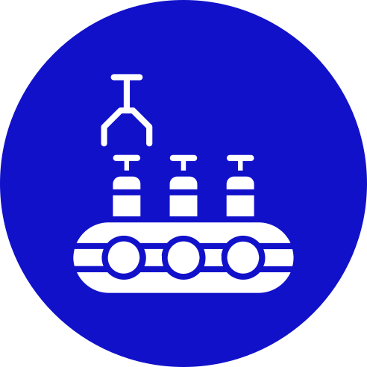
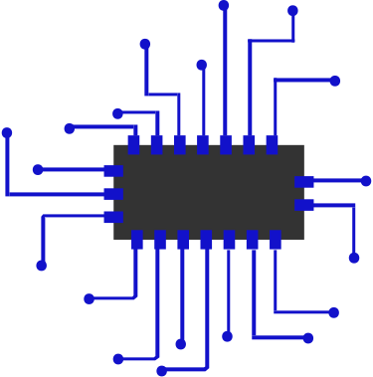

OPTIMUM
About The Service
Our Professionals
Service
Engineering & Design
Manufacturing & Assembly
Electrical & Automation
Service & Spare Parts
We design complete solutions, from custom machinery to the specialized fixtures and apparatuses required for efficient, high quality serial production.
We transform our engineering designs into powerful and reliable machinery through a high-precision manufacturing and assembly process.
End to end management of electrical projects, from system design and panel building to on site implementation
Providing reliable after sales service, maintenance, and critical spare parts to ensure uninterrupted operations for our clients.

Slide 4
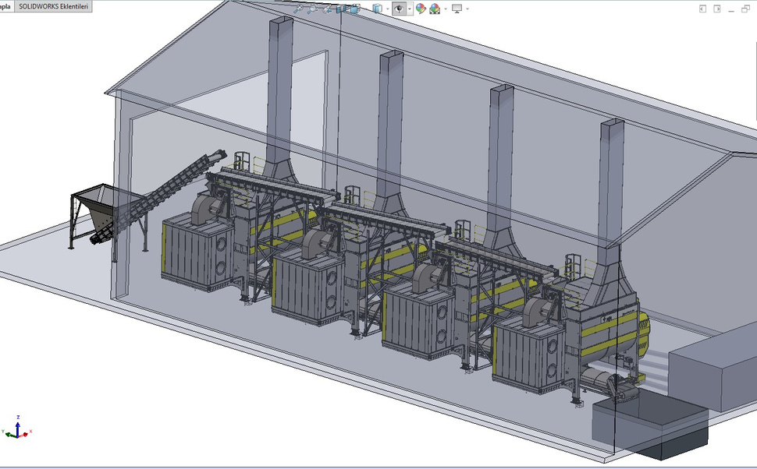
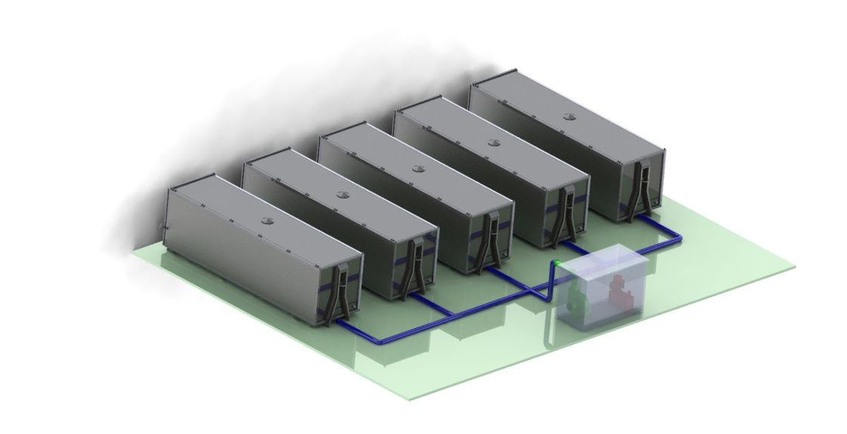
OPTIMUM
Custom Design & Engineering
A Closer Look: Custom Design
  Conceptual Design & Feasibility: We start by transforming your initial idea into a functional concept. We analyze the feasibility to ensure the project is viable, efficient, and aligns with your budget.
  Advanced 3D Modeling: Using state of the art CAD software, we create detailed and precise 3D models of every component and assembly. This allows for virtual prototyping and eliminates potential issues before manufacturing begins.
  Engineering Analysis & Simulation: Our designs are validated through rigorous engineering calculations and simulations to guarantee structural integrity, durability, and optimal performance under real world conditions.

Slide 5
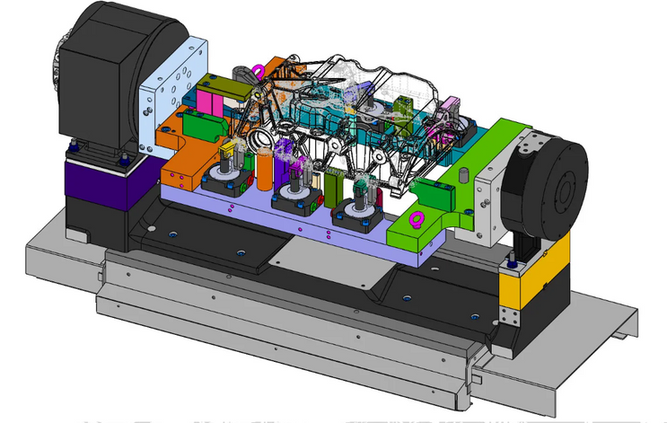
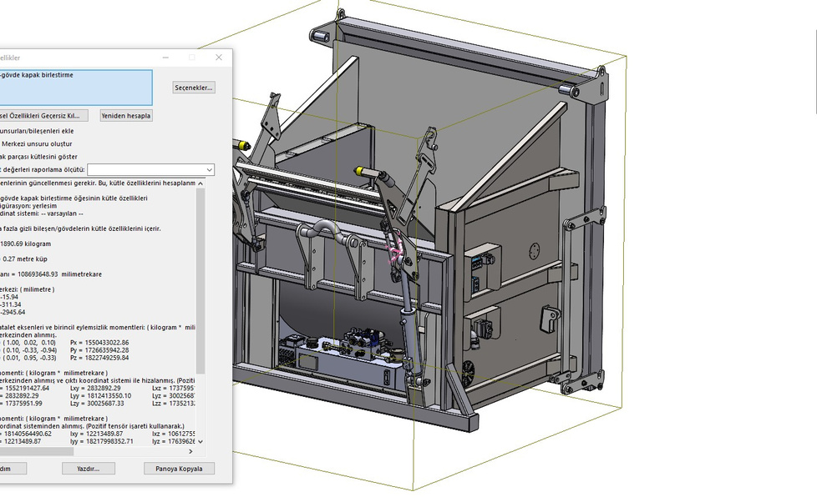
OPTIMUM
Fixtures & Apparatus Design
Beyond the machine, we engineer the tools that guarantee quality and efficiency in your production line.
  Whether it's for high volume serial production or a complex special manufacturing project, we design and manufacture custom fixtures and apparatuses. Tailored to your specific parts, these tools guarantee absolute precision and repeatability.
Notes:
4th Axis Oil Tank Machining Fixture Designed in SolidWorks
+We design and manufacture custom fixtures, jigs, and apparatuses tailored to your specific parts and assembly processes. These tools are essential for positioning, holding, and guiding components during manufacturing.
+We design and manufacture custom fixtures, jigs, and apparatuses to optimize your manufacturing process. Our solutions are engineered to deliver critical advantages for both production types:
-For Serial Production: Ensuring high speed, perfect repeatability, and minimized errors.
-For Special Production: Guaranteeing precision and stability for complex, unique, or large-scale components.

Slide 6
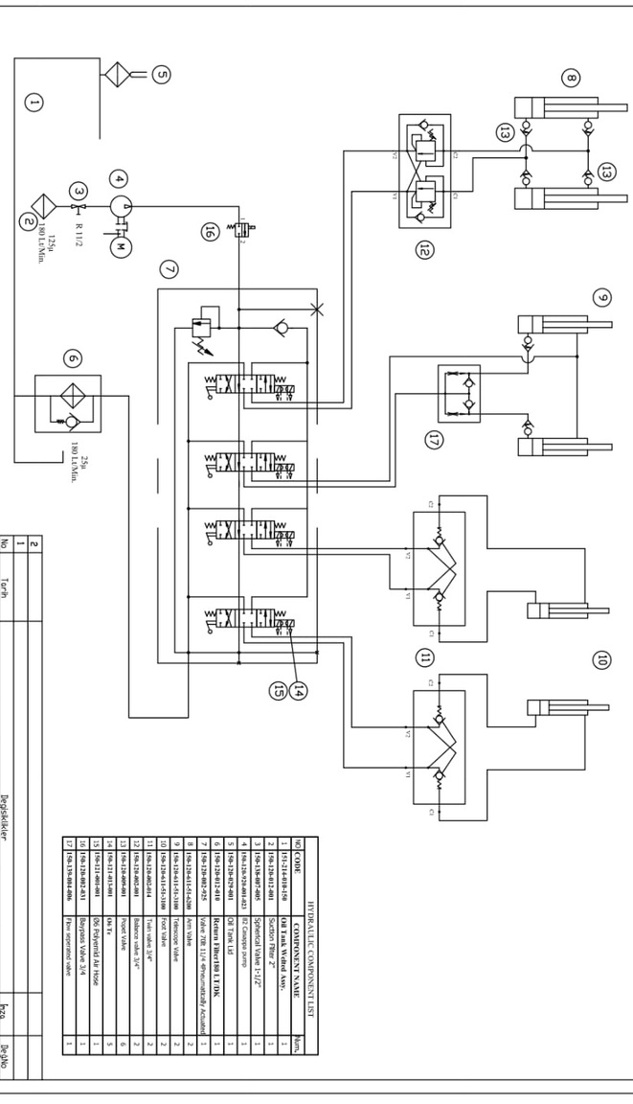
OPTIMUM
Hydraulic System
Hydraulic System Design for Power and Precision
  Circuit Design & Calculation: We design custom hydraulic circuits tailored to the specific force, speed, and control requirements of your machine.
  Component Selection: Based on detailed calculations, we select high quality, industry proven components from pumps and valves to cylinders and filters ensuring optimal performance and longevity.
  Detailed Schematics: We provide complete, professional hydraulic schematics, like the one shown, for clear documentation and easy maintenance.
Notes:
For reliable and powerful motion, we engineer custom hydraulic systems from the ground up.

Slide 7
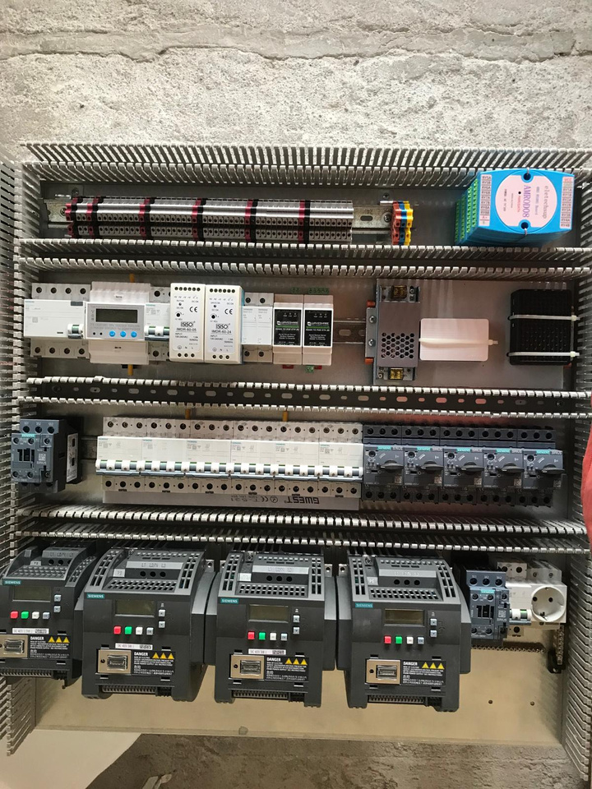
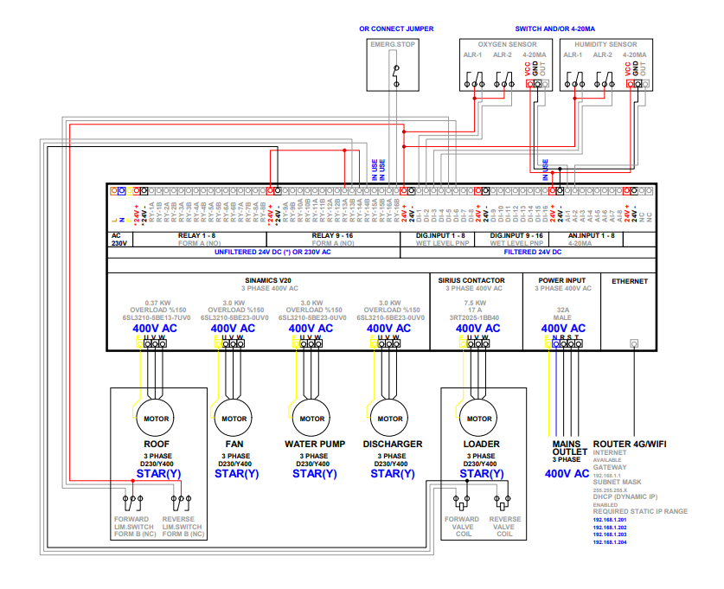
OPTIMUM
Advanced Automation
Robust Hardware & Precise Control
High Quality Control Panels
Our automation panels are professionally assembled using top tier components to ensure durability and flawless operation even in demanding industrial environments.
Precise Motor Control
We utilize industry leading to provide precise, efficient, and reliable control over every motor in your system.
Designed for Safety
Safety is our priority. Our systems are designed with proper grounding and integrated emergency stop functionalities to protect both your operators and your equipment.
Notes:
We build the brain of your machine with industry-leading components for maximum reliability and performance.

Slide 8
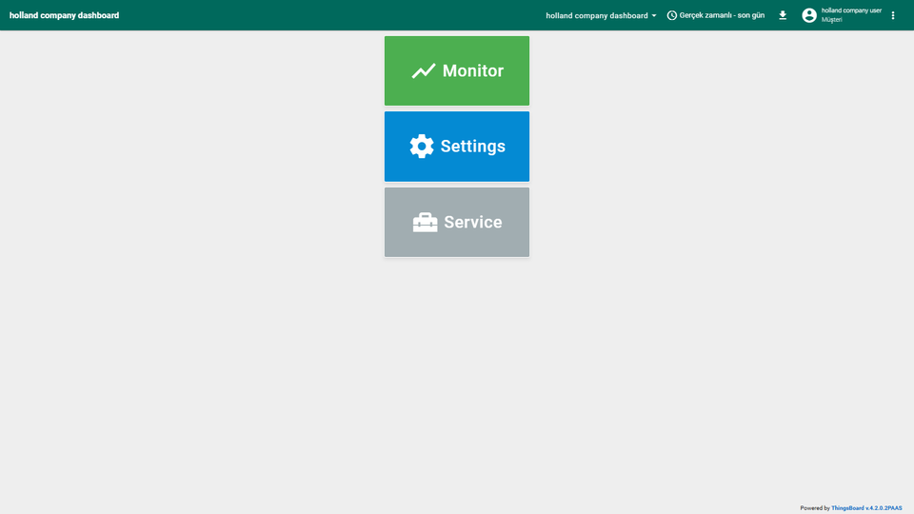
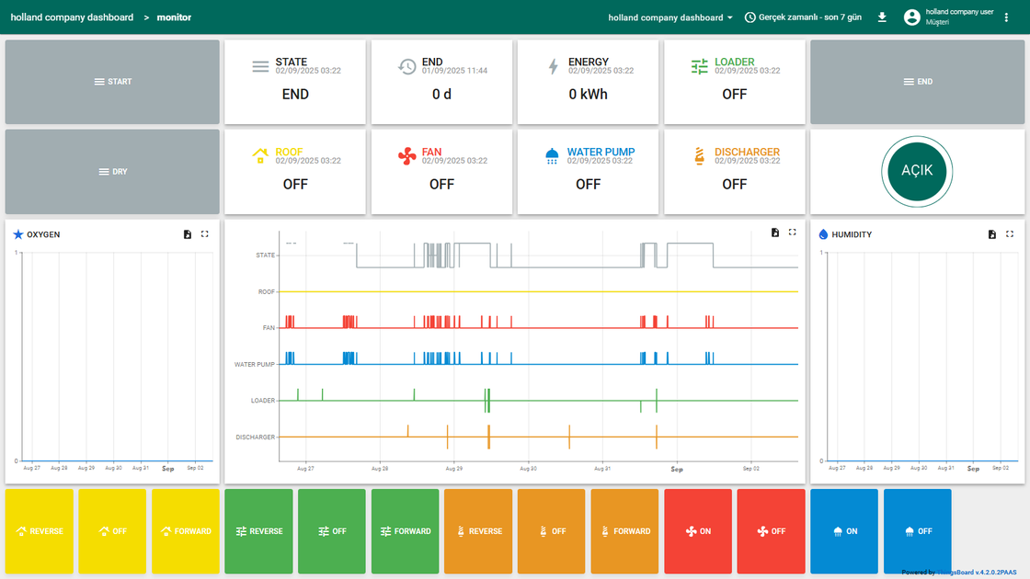
OPTIMUM
Real Time Monitoring
Total Control, From Anywhere
24/7 Remote Access
Securely access live production data from any desktop or mobile device.
Live Data & Analytics
Track critical data like oxygen and humidity levels with real-time, time-series charts.
Proactive Alerts & Alarms
Instantly see the status of all systems and get notified of potential issues before they become problems.
Notes:
Monitor and manage your production from anywhere, at any time, through our powerful and secure cloud-based dashboard.
Full Remote Access: Access your machine’s control panel securely from any desktop or mobile device with an internet connection.
Real-Time Data Monitoring: Keep track of critical production data, such as oxygen and humidity levels, with live, time-series charts for detailed analysis.
Easy Parameter Adjustment: Effortlessly fine-tune operational parameters like motor speeds, cycle times, and alarm thresholds directly from the intuitive settings screen.
Uninterrupted Operation: The core automation logic is designed to run independently, ensuring your production continues smoothly even if the internet connection is lost

Slide 9
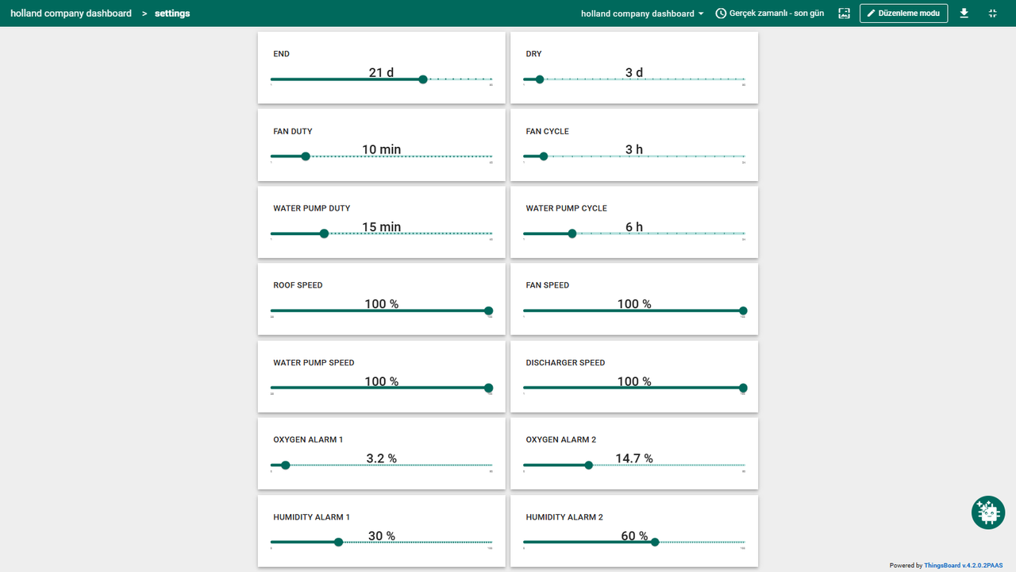
OPTIMUM
Control & Settings
Effortless Control & Parameter Settings
  Intuitive Parameter Control: Easily fine-tune motor speeds, cycle times, and alarm thresholds with a simple and clear interface.
  Reliable Offline Operation: The core automation logic runs independently, ensuring production continues 24/7, even if the internet connection is lost.
  Optimize On-the-Go: Make adjustments and optimize your process in real-time without needing to be physically at the facility.
Notes:
Monitor and manage your production from anywhere, at any time, through our powerful and secure cloud-based dashboard.

Slide 10


OPTIMUM
Process Optimization & Lean Consulting
Beyond the Machine
A high performance machine is only the first step. We help you build a high-performance process around it to unlock your true production potential.
What We Offer ?
  We analyze your entire production flow, from raw material to finished product, to identify bottlenecks, delays, and non value added steps.
  We guide you in implementing core Lean principles to systematically eliminate waste in areas like overproduction, waiting times, inventory, and motion.
  We help you establish Key Performance Indicators (KPIs) to measure what matters, allowing for data driven decisions and continuous improvement.
Up to +30%
Up to -20%
Up to -40%
Up to +15%
Productivity Increase
Reduction in Operational Costs
Decrease in Production Cycle Time
Increase in First Pass Yield (Quality)
Notes:
Increased Throughput: Produce more with the same resources.
Reduced Operational Costs: Minimize waste and improve resource utilization.
Consistent Quality: Standardize processes to reduce defects and rework.
Higher Profitability: A more efficient process directly translates to a healthier bottom line.

Slide 11

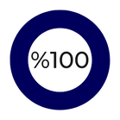
OPTIMUM
A Full-Service Partnership
The Optimum Advantage: A Single, Reliable Partner
Understanding your needs, creating the solution.
Building your high-performance machine.
Seamless Process: Our integrated services eliminate the delays and communication gaps that come from using multiple vendors. We manage everything from the first drawing to final support.
YOUR
SUCCESS
Lifetime Value: Our partnership doesn't end at delivery. The data and experience from our service activities continuously improve our next generation of designs, ensuring long term value for you.
Seamless integration into your facility.
Long term partnership for reliability.
Successful machine installations delivered to our partners.

Slide 12
Optimum Solutions Engineering, Import & Export, Industry & Trade Co.
THANK YOU
serimbaysun@gmail.com
End Slide
Optimum Solutions Engineering

